Slide 1
Ideate and implement a system to enhance the quality of education in rural areas.
CSE7101- Capstone Project
Review-1
Batch Number:COM_21
Under the Supervision of,
Mr..Sunil Kumar Sahoo
Assistant Professor
School of Computer Science and Engineering
Presidency University
Roll Number | Student Name
20221COM0019 | Makandar Saba Fareen
20221COM0052 | Pikkili Sai Tarishma
20221COM0039 | Billa SunilKumar
Name of the Program: B-Tech(COM)
Name of the HoD: Dr. Pallavi R
Name of the Program Project Coordinator: Ms. Benitha Christinal J
Name of the School Project Coordinators: Dr. Sampath A K , Dr. Geetha A

Slide 2
Problem Statement :
Organization: Presidency University
Category : Software
Problem Description:
In many rural areas, trails remain undocumented, poorly maintained, or difficult to access due to a lack of reliable information. Students and community members often struggle with limited resources, weak internet connectivity, and language barriers that prevent them from using existing trail applications. Current platforms are designed mainly for recreational users in urban contexts, overlooking the educational and safety needs of rural students. This gap results in missed opportunities for outdoor learning, reduced community engagement, and challenges in preserving local knowledge and safe navigation of natural spaces.

Slide 3
Problem Statement:
Rural students lack access to quality learning resources, teacher support, and performance tracking. Despite rising smartphone and internet use, no dedicated Android app exists to address these needs, limiting the role of technology in improving rural education.
Objectives:
Provide access to digital learning materials for registered students
Offer recorded classes or lectures that students can listen to anytime.
Enable students to take quizzes directly within the app
Track and display individual progress for each registered student.
Maintain secure student registration and login for personalized access.
Enhance engagement through an interactive and user-friendly mobile interface.

Slide 4
Background & Related Work:
Students in rural areas often lack reliable information about local trails, which limits safe access and outdoor learning opportunities. Existing trail apps such as AllTrails or HikeFit mainly focus on urban recreational users, depend on constant internet, and overlook the needs of rural students. Research on participatory mapping and projects like OpenStreetMap demonstrate how community-driven approaches can successfully document trails and engage local youth. Building on these efforts, a student-centered, lightweight, and offline-capable solution can better support education and community stewardship.
Innovation / Novel Contributions:
This project introduces a student-centered trail application tailored for rural communities. Unlike mainstream trail apps, it emphasizes lightweight design, offline access, and local language support to address digital-divide challenges. The innovation lies in combining participatory mapping with an educational focus, enabling students to map, share, and validate trails as part of their learning process. Contributions include creating a low-bandwidth platform that empowers rural youth, fosters community stewardship of natural resources, and integrates outdoor exploration with classroom activities for meaningful learning outcomes.

Slide 5
Analysis of Problem Statement
The core issue is the lack of accessible and reliable trail information in rural areas, especially for students. Existing apps fail because they rely on constant internet, focus on urban recreation, and ignore local language or low-literacy needs. This creates barriers to safe exploration, outdoor learning, and community participation. Analyzing the problem shows three critical gaps:
Technical Gap: Existing apps depend on high-speed internet and large storage, which are not suitable for rural areas.
Social Gap: Students and local communities are not actively involved in mapping or maintaining trail information.
Educational Gap: Trails are underutilized as resources for outdoor learning, skill-building, and community engagement.

Slide 6
Technology Stack Components
Software Components :
Frontend Framework: React Native (cross-platform mobile app)
Backend Framework: Node.js with Express
Database: MongoDB / Firebase (for scalable and real-time data)
APIs & Services: Google Maps API / OpenStreetMap API (mapping & navigation)
Authentication: Firebase Auth or OAuth 2.0
Offline Support: SQLite / Room DB (local caching)
Cloud Hosting: AWS / Firebase Hosting.

Slide 7
Github Link
Github Link
https://github.com/sabafareen/Ideate-and-implement-a-system-to-enhance-the-quality-of-education-in-rural-areas.

Slide 8
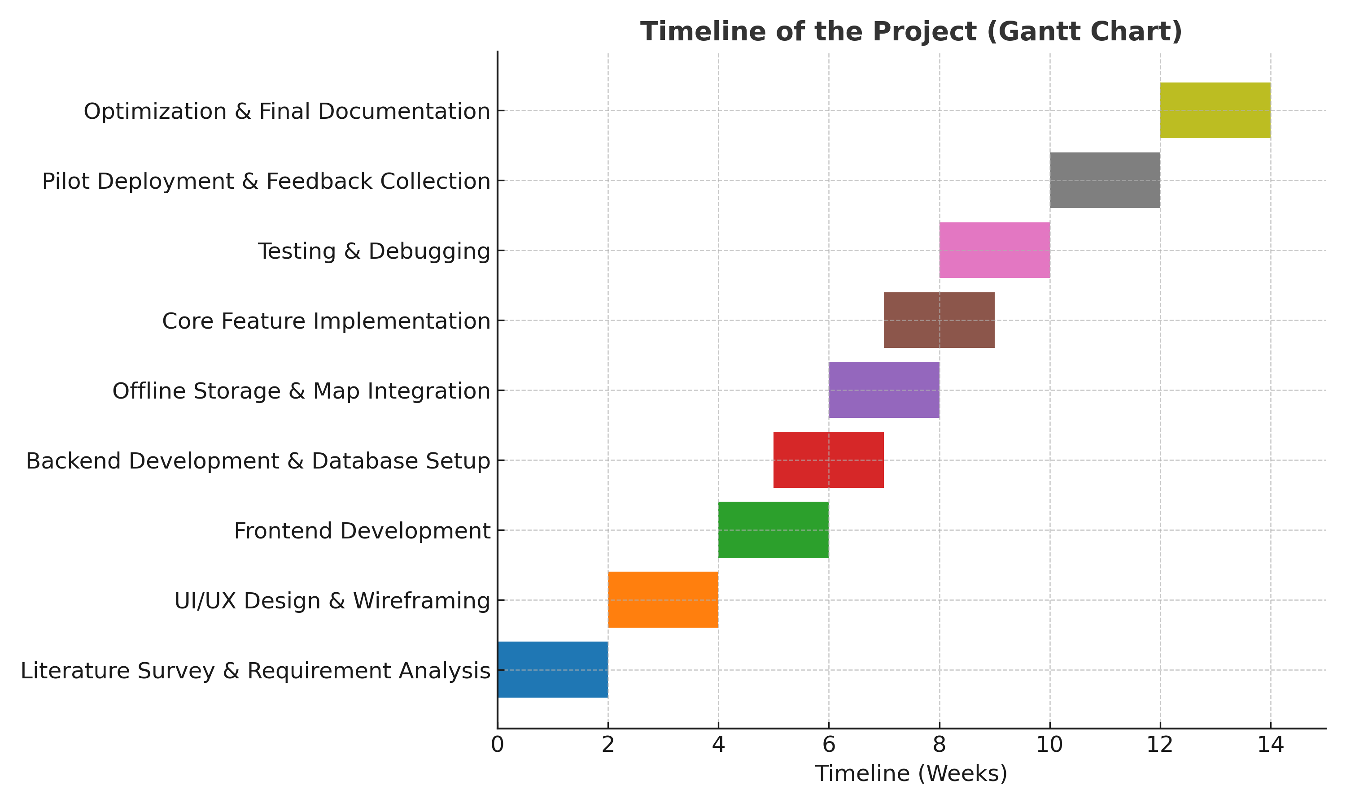
Timeline of the Project (Gantt Chart)

Slide 9
References (IEEE Paper format)
[1] P. Jain, R. Kulkarni, and A. Mehra, “Cloud-Based Mobile Learning Platform for Rural Education Using Low-Cost Smartphones,” IEEE Access, vol. 12, pp. 45120–45132, 2024.
[2] S. Kumar and D. Reddy, “ICT-Enabled Smart Education Framework for Rural Communities,” in Proc. 2023 IEEE Global Humanitarian Technology Conf. (GHTC), pp. 368–374, 2023.
[3] A. Verma, K. Nair, and L. Thomas, “Design and Evaluation of Student-Centered Mobile Learning Applications with Real-Time Analytics,” IEEE Transactions on Learning Technologies, vol. 16, no. 3, pp. 421–430, 2023.
[4] R. Singh and M. Bose, “Integrating Cloud Services and Mobile Applications for Improving Educational Outcomes in Developing Regions,” in Proc. 2022 IEEE Int. Conf. on Cloud Computing in Emerging Markets (CCEM), pp. 95–100, 2022.
[5] H. Chen, Y. Zhang, and F. Li, “User Experience Design Principles for Mobile Educational Applications: An Empirical Study,” IEEE Access, vol. 11, pp. 118900–118912, 2023.

Slide 10


